Slide 1
Questions
We can ask our dataset

Slide 2
Predictions
Is it possible to predict:
Income with average word length and essay length?
Income with education, sex, job, age and ethnicity?
Age with education ,job, ethnicity, drugs and status?
Offspring with education, age and status?
Sign with smoking, drinking, drugs, essay, avg word length?

Slide 3
Predictions
So I tried to predict:
Sign
Offspring
Income
Education

Slide 4
Analysis on the dataset

Slide 5
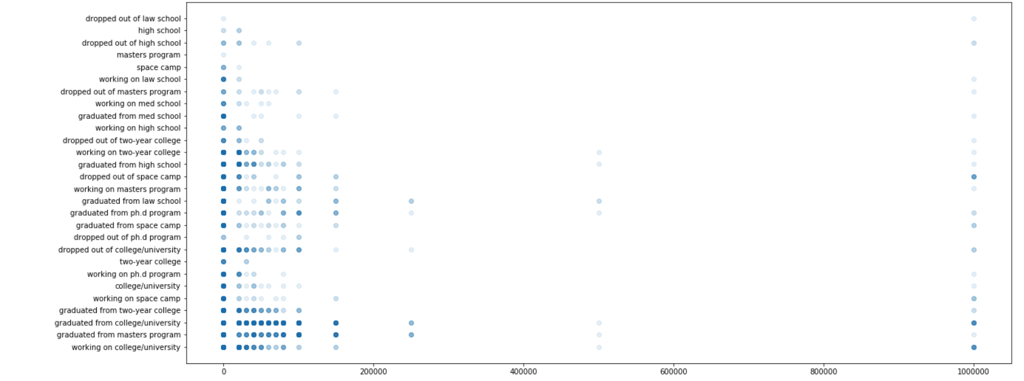
Income vs education

Slide 6
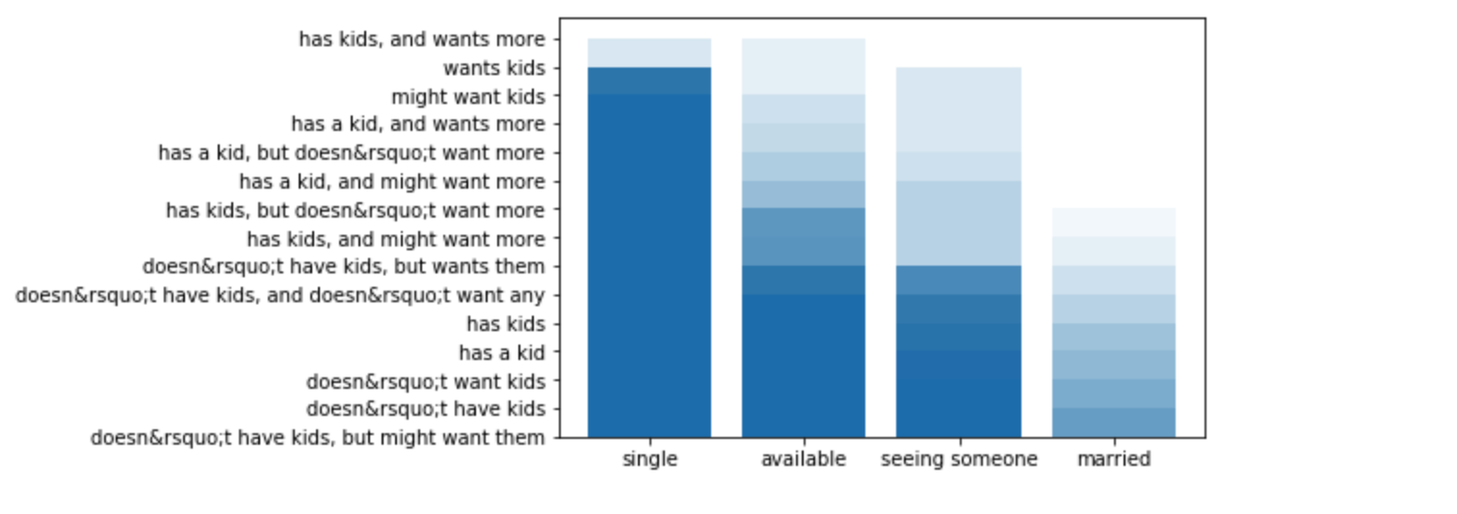
Status vs Offspring

Slide 7
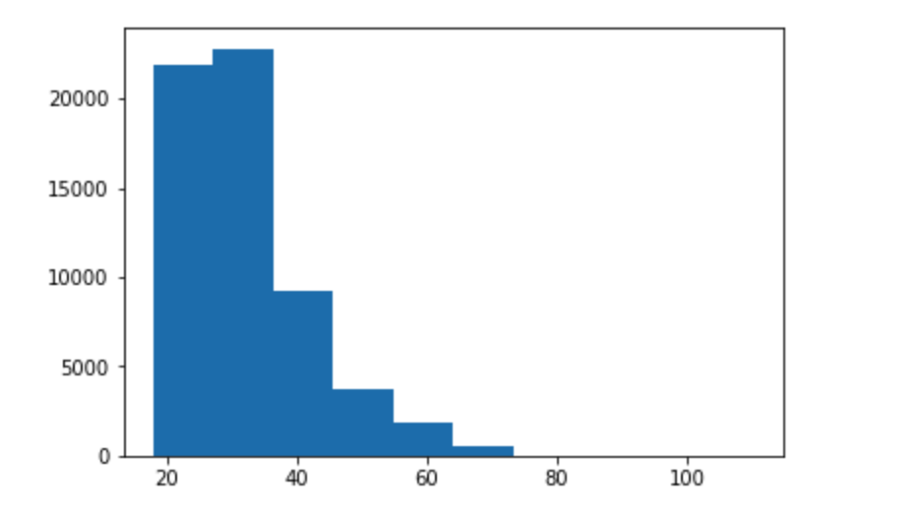
Age histogram

Slide 8
COLUMNS I CREATED
For the purpose of using text data in the model I had to create the colums with numerical representations, so I created columns:
Education code
Status code
Job code
Location code
Ethnicity code
Drinks code
Smokes code
Drugs code
And two correlated with essay data: average word length(avg word lenght) and length of essay (essay len)

Slide 9
How I tried to improve models:
My methods for classification models:
I was trying to apply as many models as possible to get the best fit
For Support Vector Machines i tried different kernels
For KNeighborsClassifier i tried different n_neighbors

Slide 10
Features I used to predict sign:
feature_data = all_data[['smokes_code', 'drinks_code', 'drugs_code', 'essay_len', 'avg_word_length']]

Slide 11
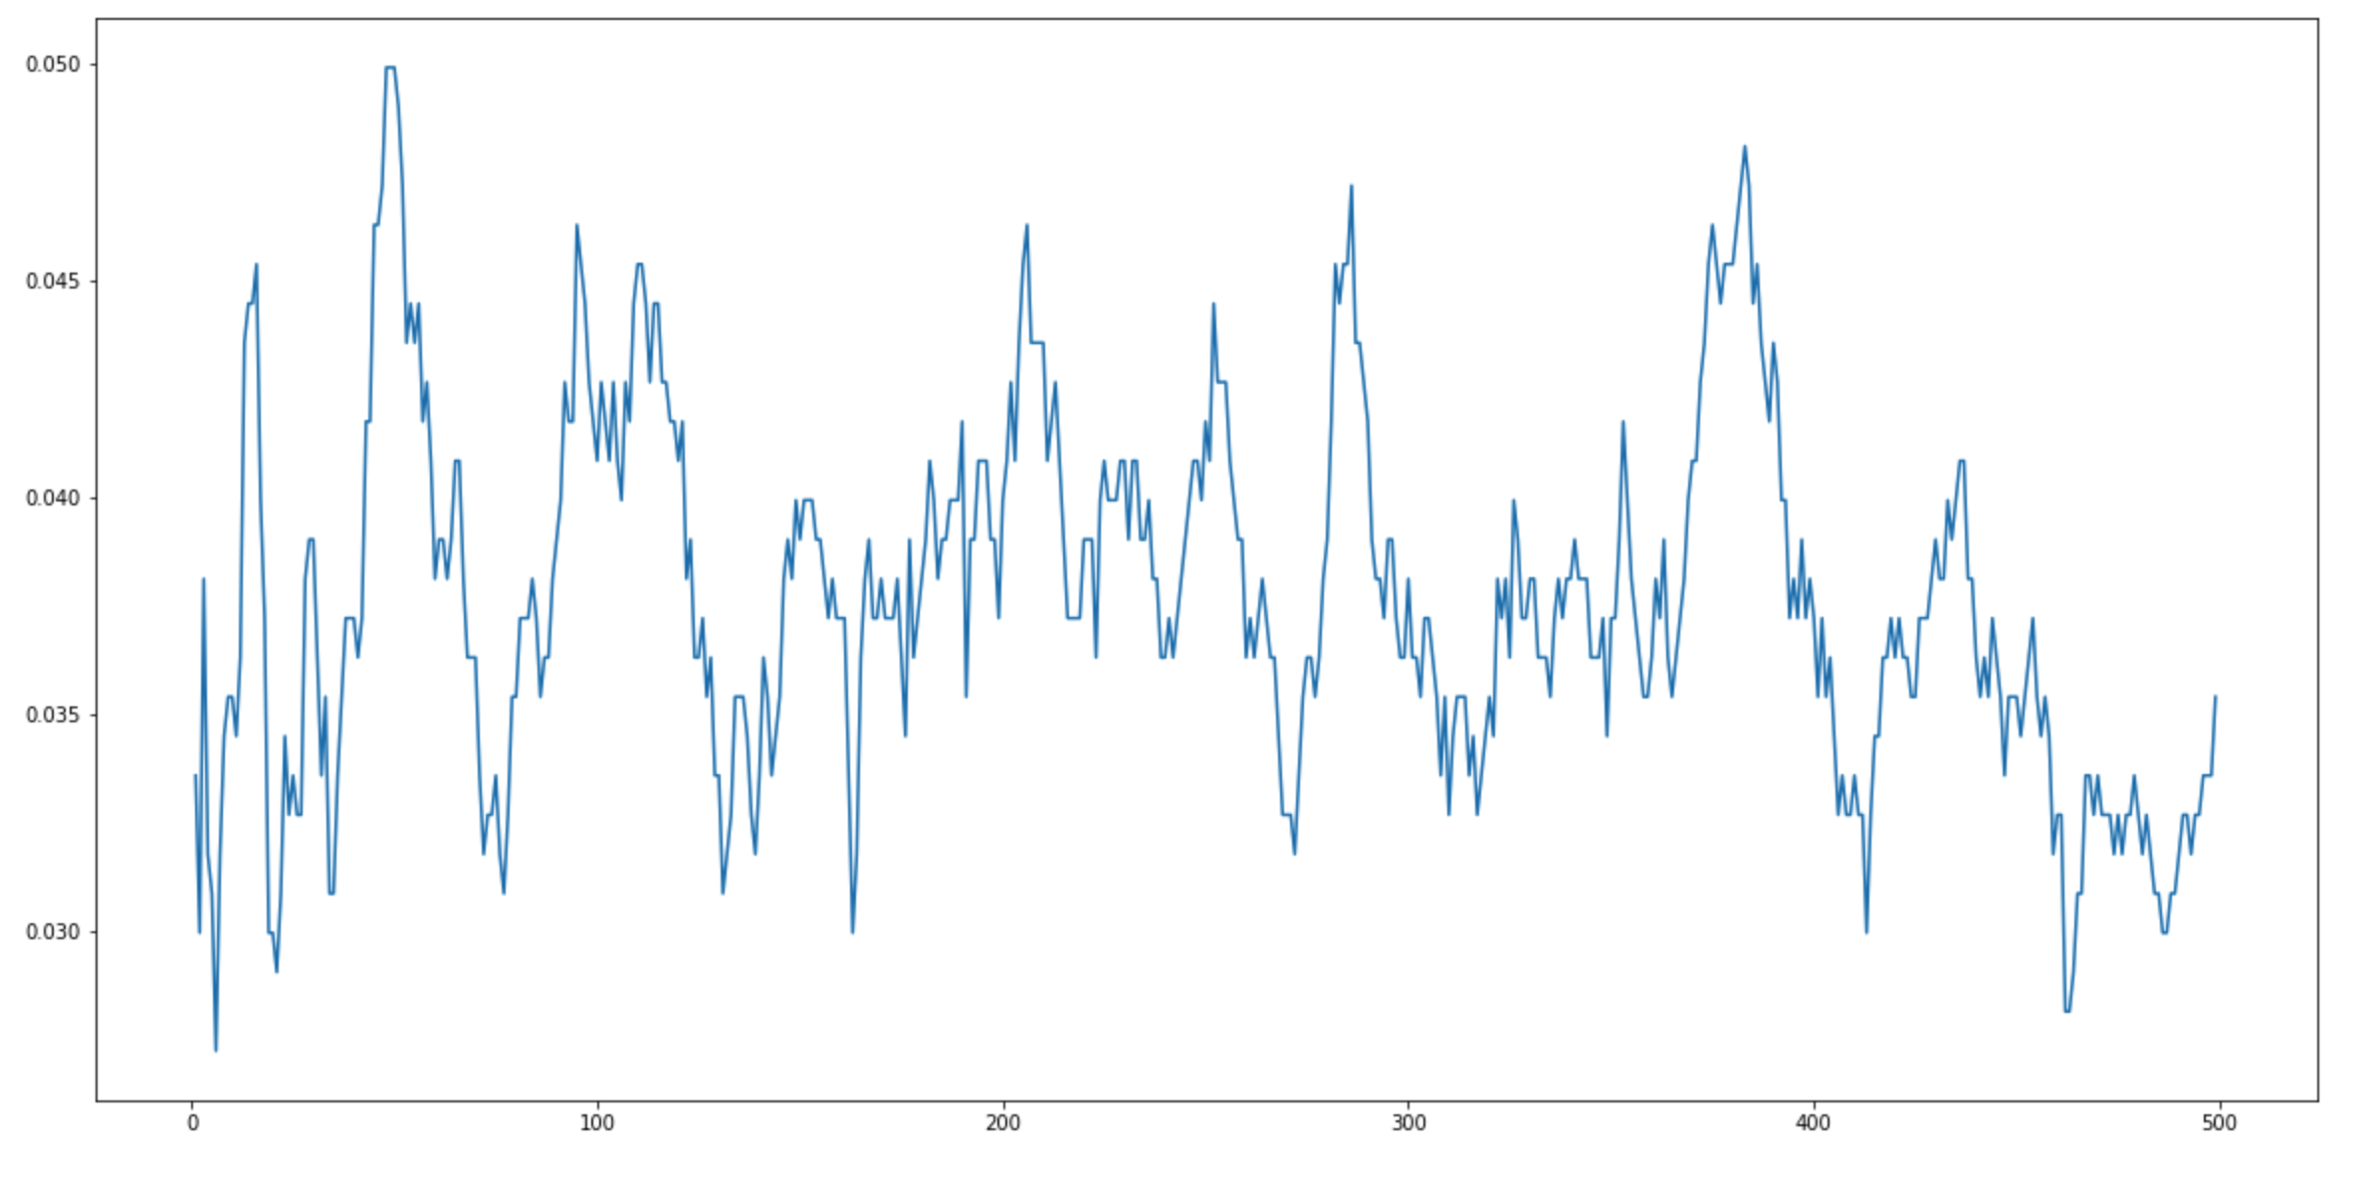
PREDICTING SIGN WITH KNN classifier
RESULTS
- KNN accuracy: 0.0499, recall = 0.027
On the chart
x = n_neighbors
Y = accuracy

Slide 12
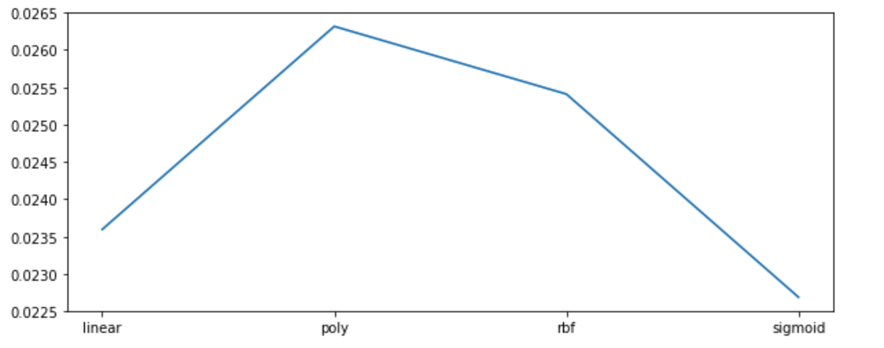
Predicting sign with SVM
RESULTS
- SVC accuracy: 0.026, precision =0,005
- The highest for kernel = poly
On the chart: x=kenrel,
y = accuracy

Slide 13
PREDICTING OFFSPRING WITH 'education_code', 'age', 'status_code'
KNN classifier:
precision =0.176,
Recall score = 0.259
Accuracy = 0.26
SUPPORT VECTOR MACHINES
precision = 0.266
accuracy = 0.297

Slide 14
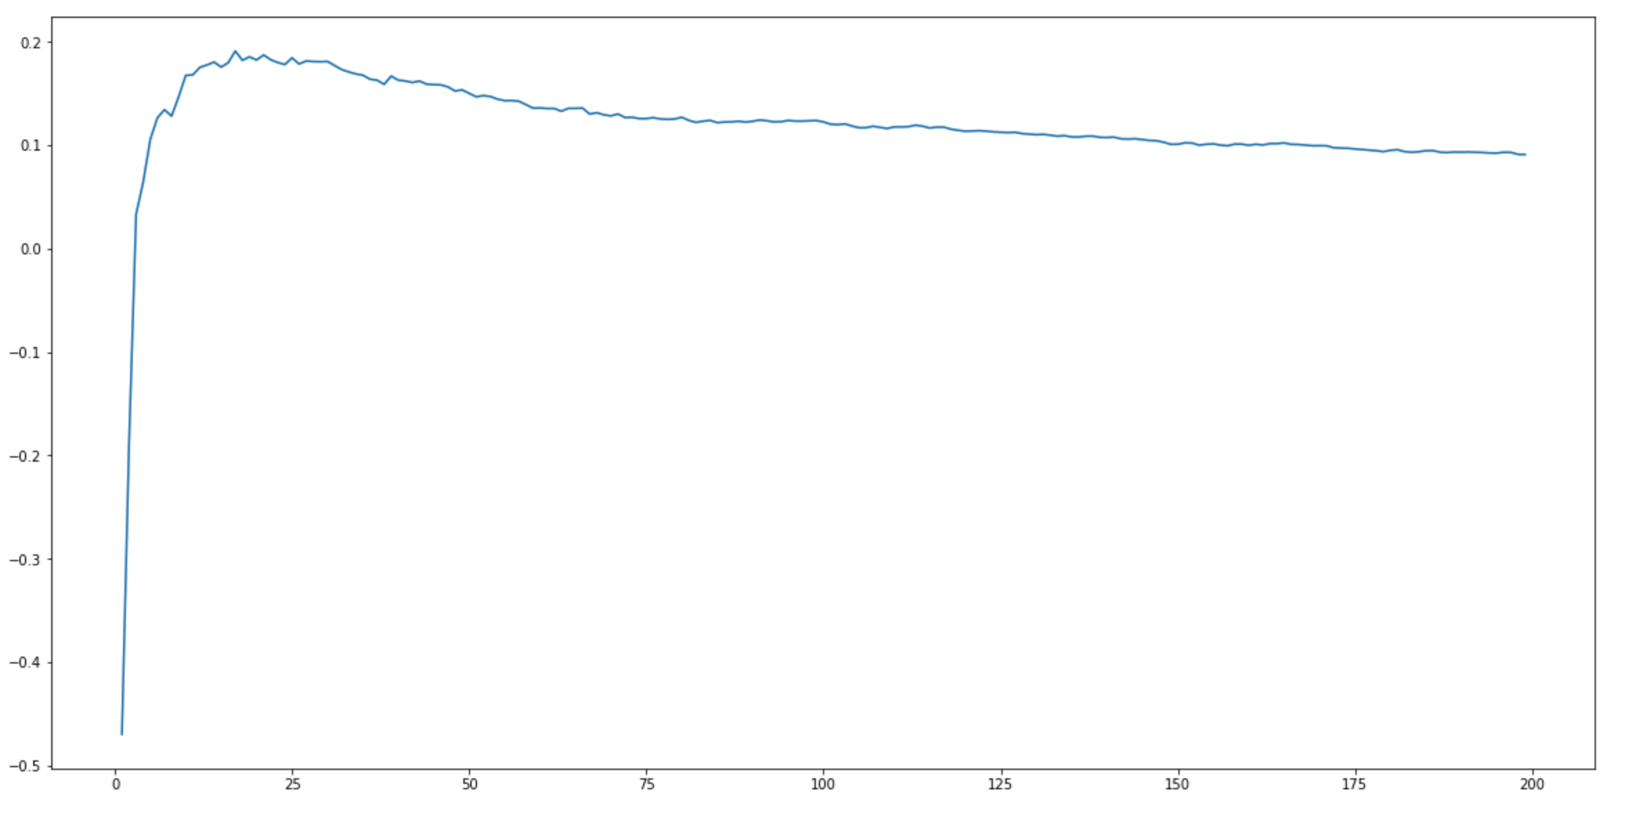
PREDICTING AGE WITH REGRESSION METHODS
KNeighbors Regressor:
Max regression score =0.191
X = N_neighbours
Y = Regression score

Slide 15
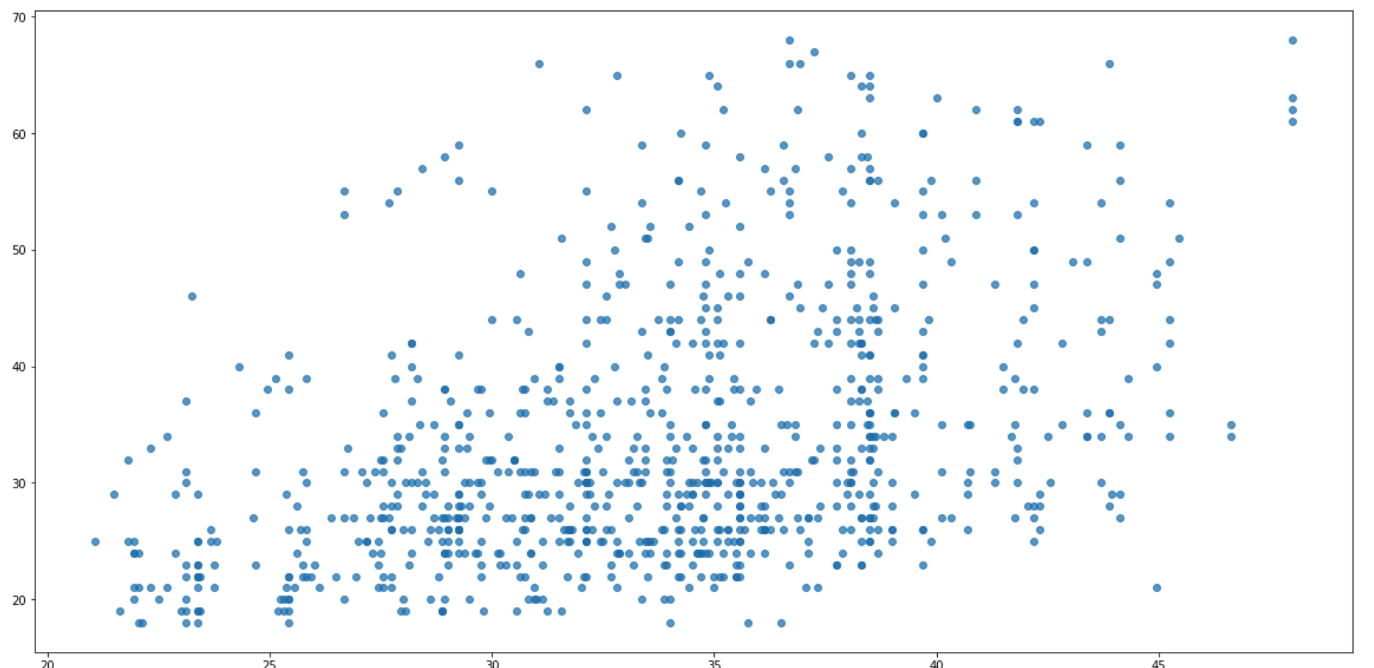
KNNREGRESSOR - AGE
Y pred vs Y test

Slide 16
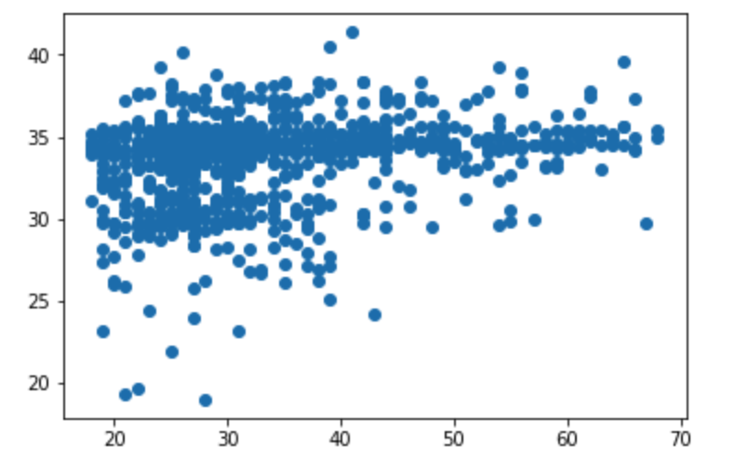
PREDICTING AGE WITH LINEAR REGRESSION
R2 score = 0.05
On the chart:
Y_pred vs Y_test

Slide 17
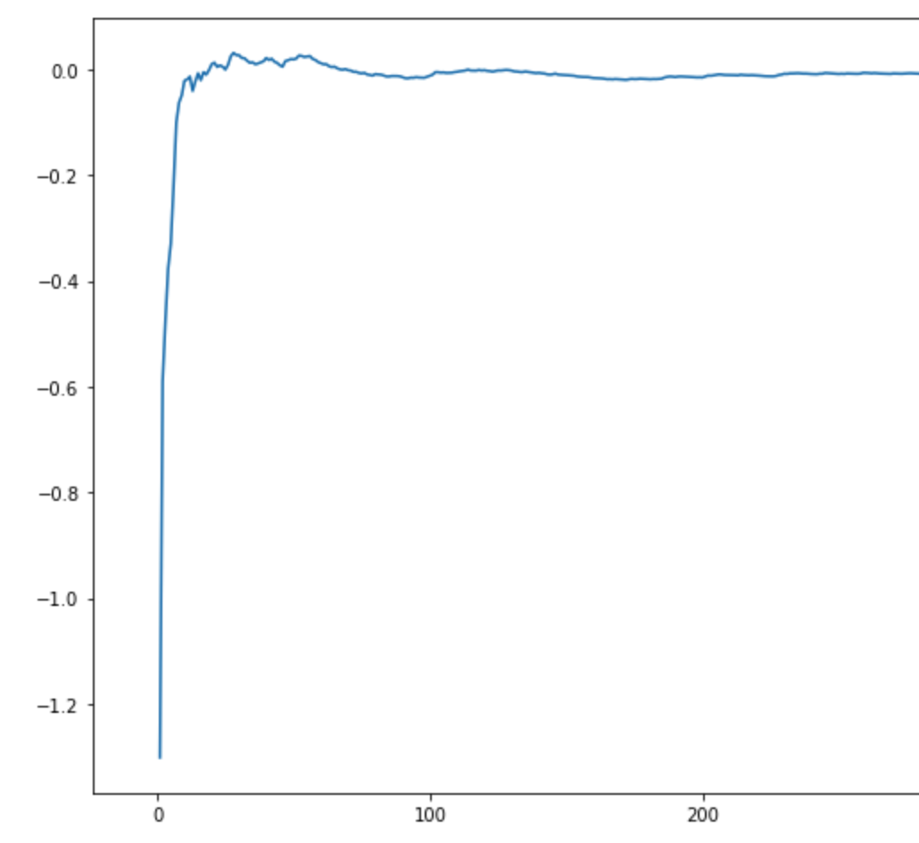
PREDICTING INCOME WITH REGRESSION MODELS
PREDICTING INCOME WITH ESSAY LENGTH AND AVG WORD
R2 SCORE FOR LINEAR REGRESSION: -0.0159
R2 SCORE FOR KNN REGRESSOR: 0.0318
ON THE CHART:
X = n_neighbours
Y = KNN REGRESSOR score

Slide 18
Thank you!
Wiktor Feduń
:)

